Slide 1

BIG DATA ANALYTICS Part – 4 “PIG”
By: Dr.Rashmi L Malghan & Ms. Shavantrevva S Bilakeri

Slide 2

Agenda:

Slide 3
Apache PIG
Pig was introduced by yahoo and later on it was made fully open source by Apache Hadoop.
It also provides a bridge to query data over Hadoop clusters but unlike hive, it implements a script implementation to make Hadoop data accessable by developers and business persons.
Apache pig provides a high level programming platform for developers to process and analyses Big Data using user defined functions and programming efforts.
In January 2013 Apache released Pig 0.10.1 which is defined for use with Hadoop 0.10.1 or later releases.

Slide 4
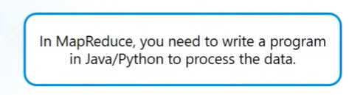
MapReduce Way: Apache PIG:
Focus on the data transformations rather than the underlying MapReduce implementation.
Apache Pig's high-level dataflow engine simplifies the development of large-scale data processing tasks on Hadoop clusters by providing an abstraction layer and leveraging the power of MapReduce without requiring users to write complex Java code.

Slide 5
Key Features and example of Pig Latin code
Declarative Language (Pig Latin)
Abstraction from MapReduce
Data Flow Model
Schema Flexibility
Optimization Opportunities
Ease of Use
-- Load data
data = LOAD 'input_data' USING PigStorage(',');
-- Filter data
filtered_data = FILTER data BY $1 > 50;
-- Group and aggregate
grouped_data = GROUP filtered_data BY $0;
result = FOREACH grouped_data GENERATE group, AVG(filtered_data.$1);
-- Store the result
STORE result INTO 'output';

Slide 6
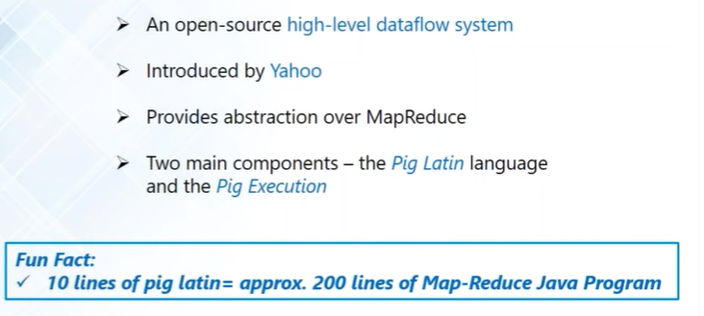
Apache PIG:

Slide 7
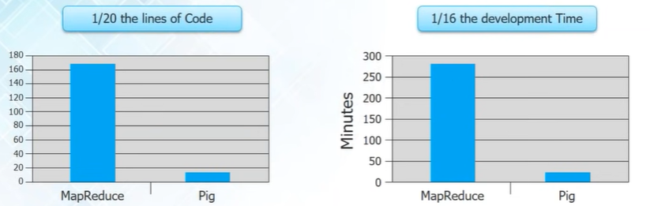
Why to Opt Pig instead of MapReduce:

Slide 8
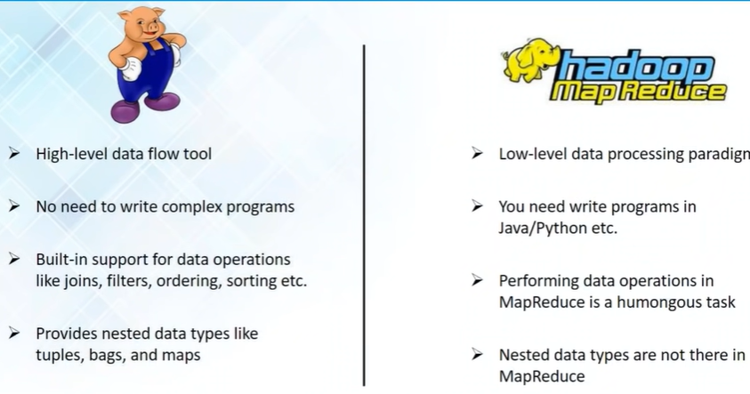
PIG VS MapReduce

Slide 9
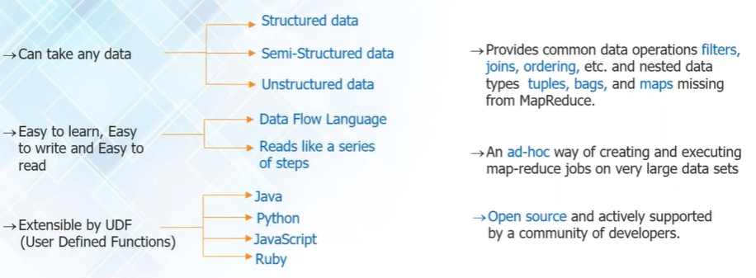
Apache Pig: Advantages

Slide 10
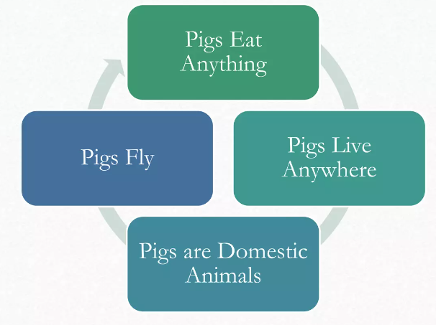
PIG Anatomy
Data flow Language- pig latin
Interactive shell- Grunt
Prig interpreter and execution engine
PIG supports:
1.HDFS commands
2.UNIX shell operators
3.Relational operators
4. Positional operators
5. Mathematical functions
6. User defined functions
7. Complex data structures
PIG Philosophy

Slide 11
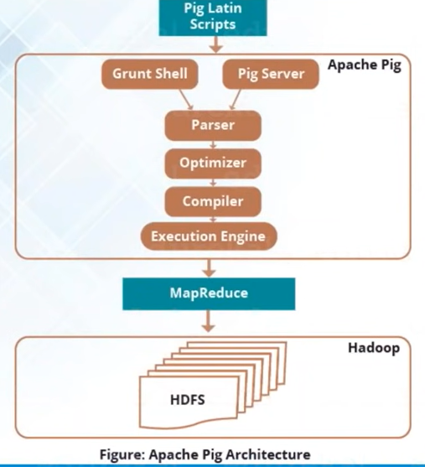
Apache Pig – Architecture / Pig MapReduce Engine
Pig Latin Scripts: Execute queries over big data.
Grunt Shell: Native shell provided by Apache Pig, to execute pig queries.
Submit pig scripts to java client to pig server & execute over Apache pig.
Compiler: Converts pig latin scripts to Apache MapReduce code
Executed using executing engine over Hadoop cluster

Slide 12
Operators in Apache Pig
Pig Latin Operators are the basic constructs that allow data manipulation in Apache Pig. Some commonly used operators include:
LOAD and STORE: These operators are used to read and write data.
FILTER: The FILTER operator is used to remove unwanted data based on a condition.
GROUP: The GROUP operator is used to group the data in one or more relations.
JOIN: The JOIN operator merges two or more relations.
SPLIT: The SPLIT operator is used to split a single relation into two or more relations based on some condition.

Slide 13
Pig Syntax used for Data Processing
X= LOAD ‘file name.txt’; #directory name
………..
Y= GROUP ….;
……..
Z= FILTER …;
…..
DUMP Y; #view result on screen
……..
STORE Z into ‘temp’

Slide 14
Example Latin Script: find the total distance travelled by a flight
-- Load the flight data
flight_data = LOAD 'path/to/flight_data' USING PigStorage(',') AS (date:chararray, distance:int);
-- Filter out empty or invalid distance values
filtered_data = FILTER flight_data BY distance is not null and distance >= 0;
-- Calculate the total distance covered
total_distance = FOREACH (GROUP filtered_data ALL) GENERATE SUM(filtered_data.distance) as total_distance;
-- Display the result
DUMP total_distance;

Slide 15
Question: load the student data (assuming data contains rollno, name, gpa),
romove the students whose gpa is less than 5.0.
From the filtered data, find the student name with highest gpa.
Display and Store the result to output file

Slide 16
SOLUTION
A = load ‘student’ (rollno, name, gpa) #A is a relational table not a variable
A = filter A by gpa>5.0
A = foreach A generate Upper (name);
STORE A INTO ‘myreport’
Note: by default columns are indexed with $01, $02, $03 when USING PigStorage is not used.

Slide 17
--Load student data
student_data = LOAD 'path/to/student_data' USING PigStorage(',') AS (rollno:chararray, name:chararray, gpa:float);
-- Filter out students with GPA less than 5.0
filtered_data = FILTER student_data BY gpa >= 5.0;
-- Find the student with the highest GPA
max_gpa_student = ORDER filtered_data BY gpa DESC; top_student = LIMIT max_gpa_student 1;
-- Display the result
DUMP top_student;
-- Store the result in an output file
STORE top_student INTO 'path/to/output' USING PigStorage(',');

Slide 18
PIG LATIN IDENTIFIERS and COMMENTS
Identifiers are the names assigned to field or the other data structures
Should begin with a letter and should be followed only by letters and underscores
Examples for valid: Y, A1, A1_2014, Sample
Examples for invalid: 5, sales$, sales%, _sales
Single line comment begin with “--”
Multiline comment begin with “/* and end with */”

Slide 19
Case Study: Twitter
Objective: To increase their user base / Enhance their offerings
Procedures: To Extract insights monthly/weekly/daily
Results: To scale up their infrastructure so that they will be able to handle larger user base they are targeting.

Slide 20
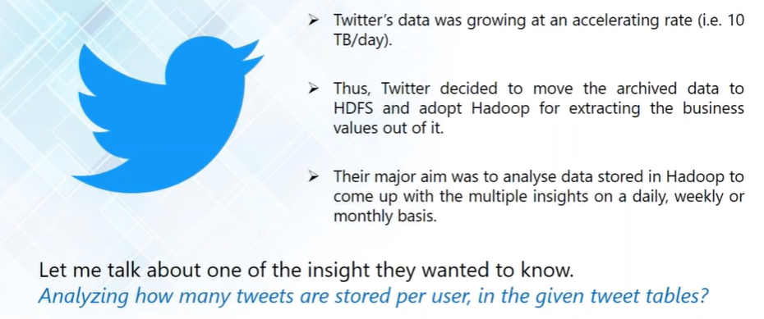
Case Study: Twitter

Slide 21
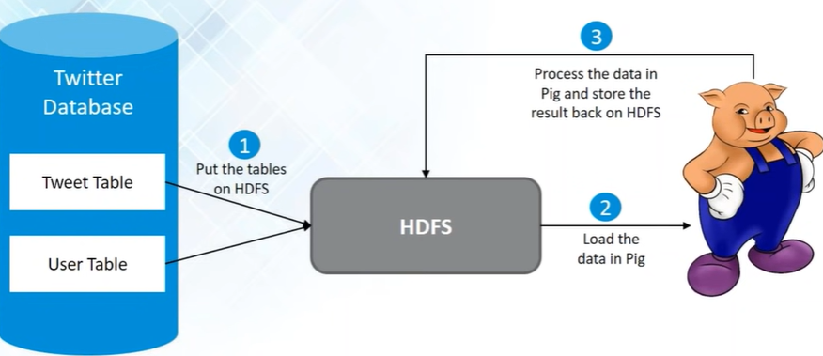
High Level implementation – HDFS & Pig
Twitter Database had many tables, in which archive data was stored.
The insight they want to extract was related to :Tweet & user table.

Slide 22
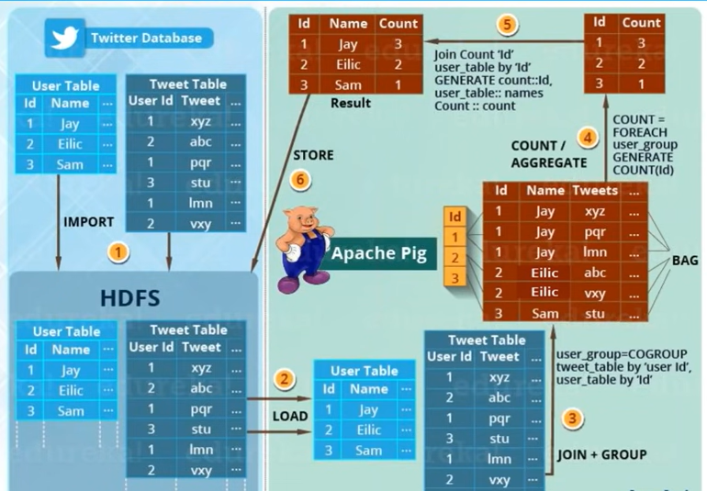
Implementation Flow - Detail
Import -Sqoop- transfer data between RDBM to HDFS or HDFS to RDMS
Twitter used Pig instead of mapreduce thus –saved their time and effort.

Slide 23
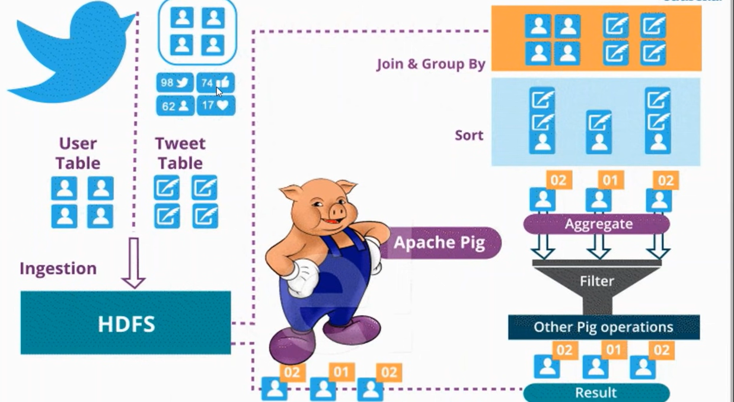
Case Study: Twitter

Slide 24
What happens underneath the covers when you run/submit a Sqoop import job
Sqoop will connect to the database.
Sqoop uses JDBC to examine the table by retrieving a list of all the columns and their SQL data types. These SQL types (varchar, integer and more) can then be mapped to Java data types (String, Integer etc.)
Sqoop’s code generator will use this information to create a table-specific class to hold records extracted from the table.
Sqoop will connect to cluster and submit a MapReduce job.
The dataset being transferred is sliced up into different partitions and a map-only job is launched with individual mappers responsible for transferring a slice of this dataset.
For databases, Sqoop will read the table row-by-row into HDFS.
For mainframe datasets, sqoop will read records from each mainframe dataset into HDFS.
The output of this import process is a set of files containing a copy of imported table or datasets.
The import process is performed in parallel for this reason, the output will be in multiple files.
These files may be delimited text files CSV, TSV or binary Avro or Sequence files containing serialized record data. By default it is CSV.

Slide 25
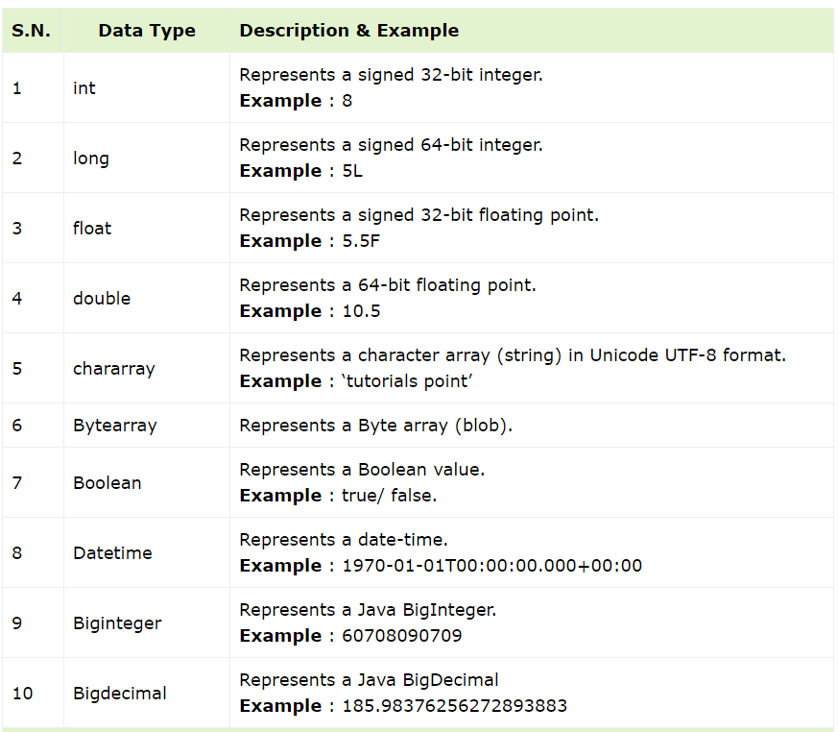
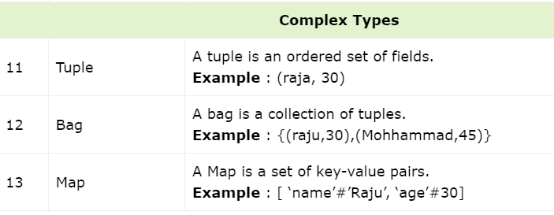
Pig Latin: Case Sensitivity
Keywords/ operators are not case sensitive.
Ex: LOAD, STORE, GROUP, FOREACH DUMP
Relations and paths are case sensitive
Function names are case sensitive Ex: PigStorage, COUNT

Slide 26
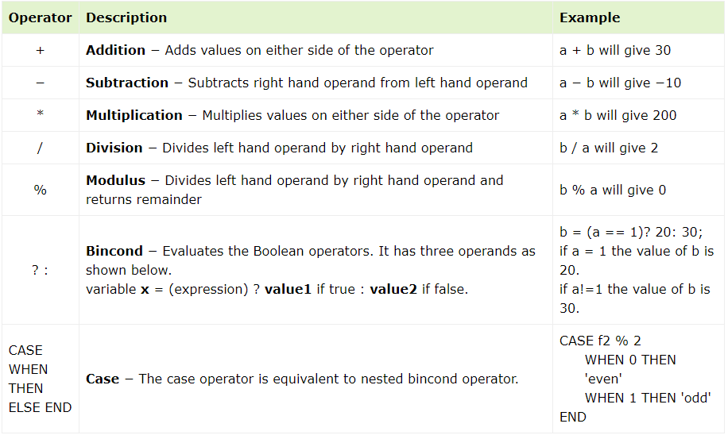
Pig Latin – Arithmetic Operators

Slide 27
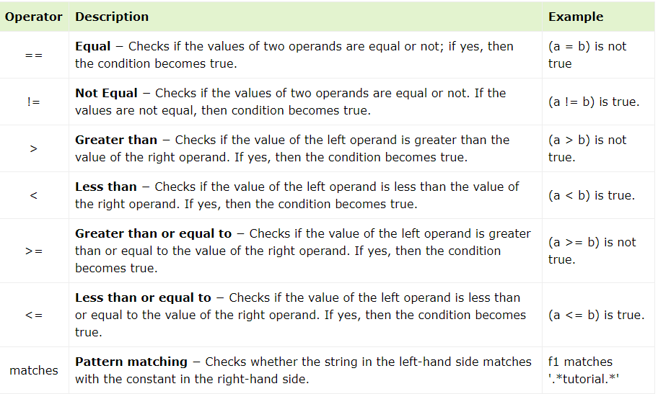
Pig Latin – Comparison Operators

Slide 28
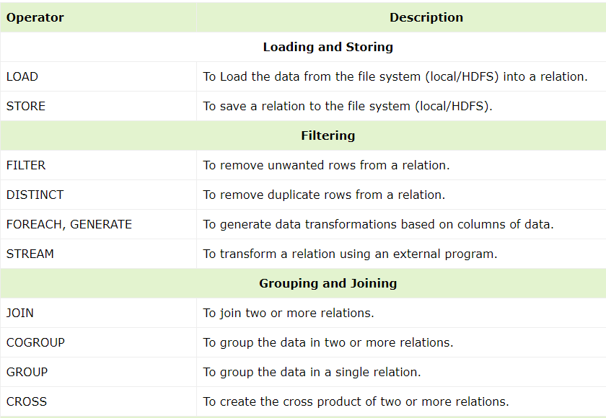
Pig Latin – Relational Operations

Slide 29
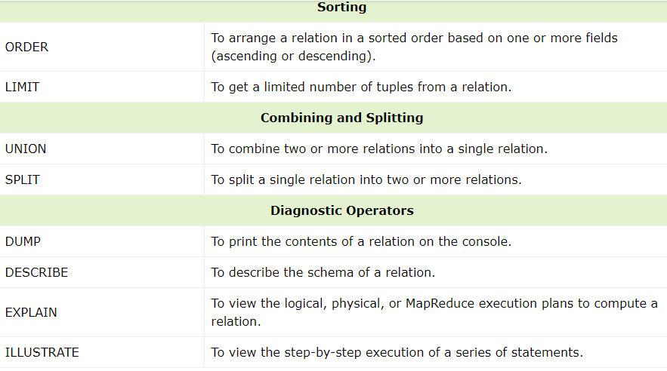
Pig Latin – Relational Operations

Slide 30
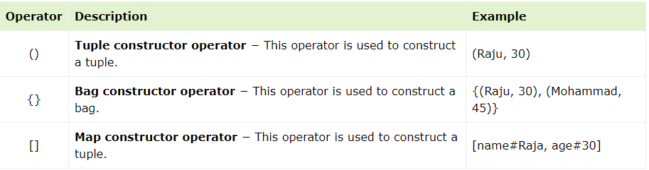
Pig Latin – Type Construction Operators

Slide 31
Apache Pig - Diagnostic Operators
To verify the execution of the Load statement, you have to use the Diagnostic Operators.
Dump operator
Describe operator
Explanation operator
Illustration operator
Dump Operator
The Dump operator is used to run the Pig Latin statements and display the results on the screen. It is generally used for debugging Purpose.
syntax of the Dump operator:
grunt> Dump Relation_Name

Slide 32
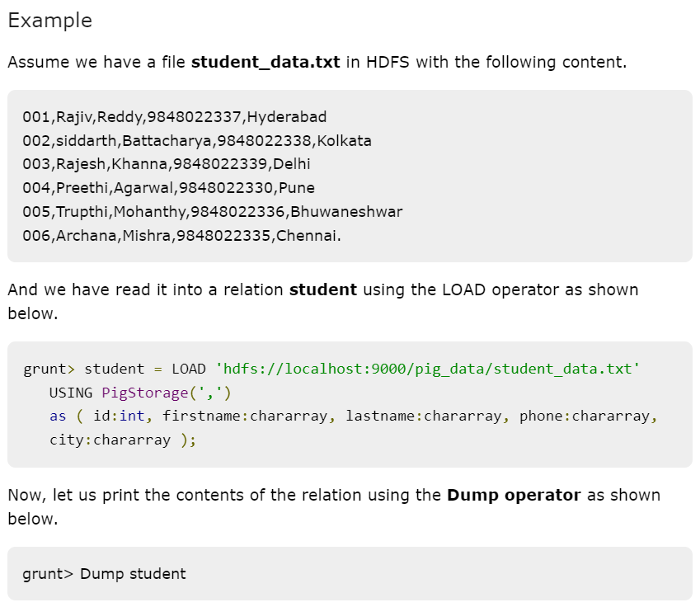

Slide 33
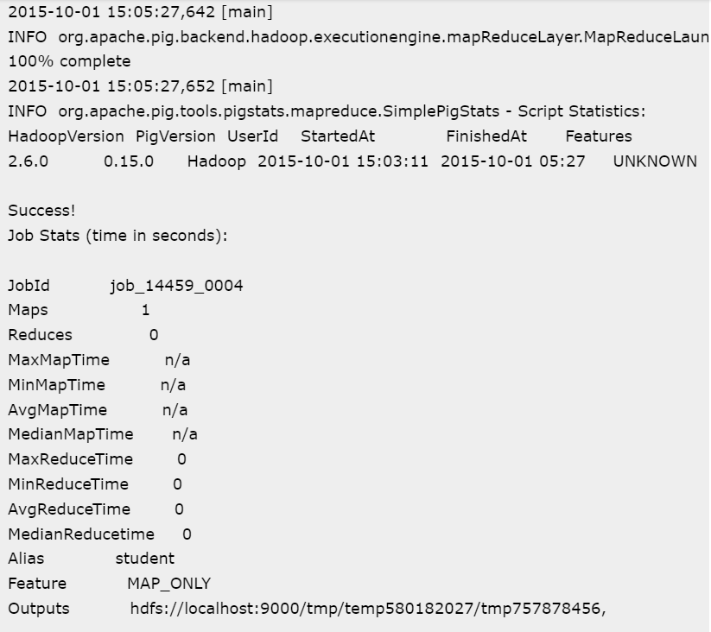
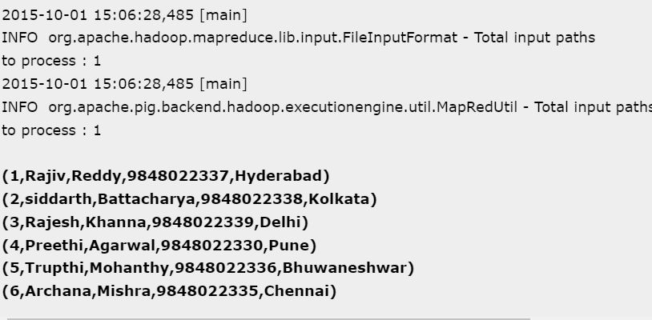

Slide 34
Describe operator
The describe operator is used to view the schema of a
relation.
Syntax
grunt> Describe Relation_name
Example
grunt> describe student;
grunt> student: { id: int,firstname: chararray,lastname: chararray,phone: chararray,city: chararray }

Slide 35
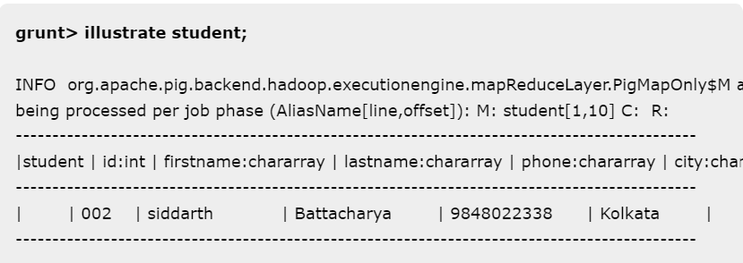
ILLUSTRATE OPERATOR
The illustrate operator gives you the step-by-step execution
of a sequence of statements.
Syntax
grunt> illustrate Relation_name;

Slide 36
GROUP operator
The GROUP operator is used to group the data in one or more relations. It collects the data having the same key.
Syntax
grunt> Group_data = GROUP Relation_name BY age;
Example
grunt> group_data = GROUP student_details by age;
(21,{(4,Preethi,Agarwal,21,9848022330,Pune),(1,Rajiv,Reddy,21,9848022337,Hydera bad)})
(22,{(3,Rajesh,Khanna,22,9848022339,Delhi),(2,siddarth,Battacharya,22,984802233 8,Kolkata)})
(23,{(6,Archana,Mishra,23,9848022335,Chennai),(5,Trupthi,Mohanthy,23,9848022336 ,Bhuwaneshwar)})
(24,{(8,Bharathi,Nambiayar,24,9848022333,Chennai),(7,Komal,Nayak,24,9848022334, trivendram)})

Slide 37
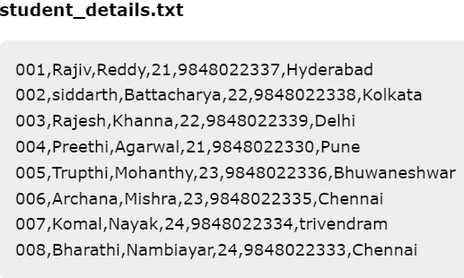
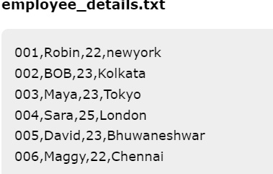
The COGROUP operator works more or less in the same way as the GROUP operator.
The only difference between the two operators is that the group operator is normally used with one relation, while the cogroup operator is used in statements involving two or more relations.
Grouping Two Relations using Cogroup
Assume that we have two files namely student_details.txt and employee_details.txt in the HDFS directory /pig_data/ .
grunt> cogroup_data = COGROUP student_details by age, employee_details by age;

Slide 38
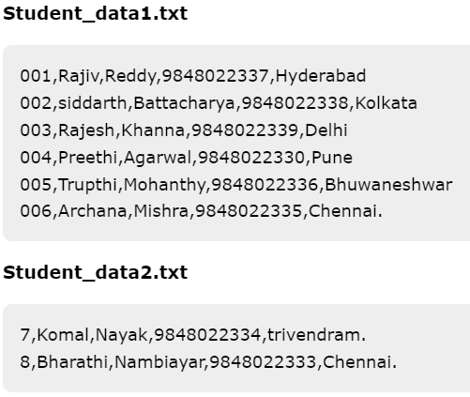
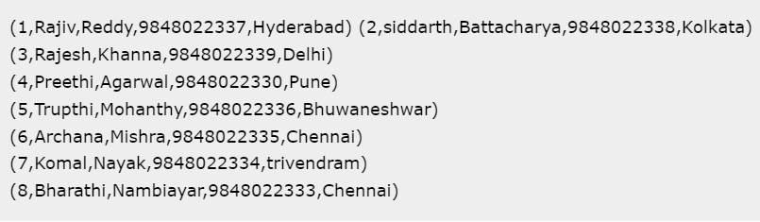
The UNION operator of Pig Latin is used to merge the content of two relations.
To perform UNION operation on two relations, their columns and domains must be identical.
Syntax: grunt> Relation_name3 = UNION Relation_name1, Relation_name2;
grunt> student = UNION student1, student2;
Output

Slide 39
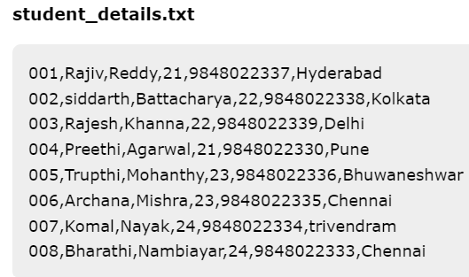
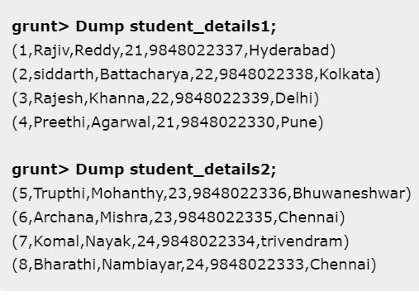
The SPLIT operator is used to split a relation into two or more relations.
Syntax: grunt> SPLIT Relation1_name INTO Relation2_name IF (condition1), Relation2_name (condition2)
Output
SPLIT student_details into student_details1 if age<23, student_details2 if (22<age and age>25);

Slide 40
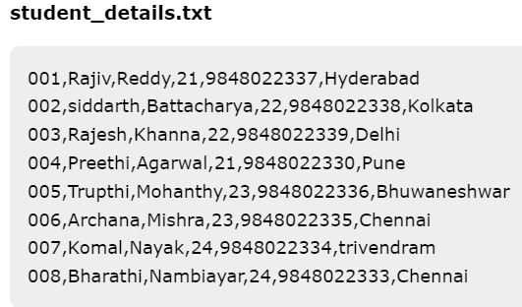
The FILTER operator is used to select the required tuples from a relation based on a condition.
Syntax
grunt> Relation2_name = FILTER Relation1_name BY (condition);
Output
(6,Archana,Mishra,23,9848022335,Chennai) (8,Bharathi,Nambiayar,24,9848022333,Chennai)
filter_data = FILTER student_details BY city == 'Chennai';

Slide 41
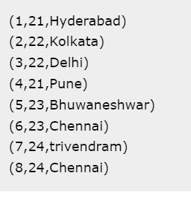
The DISTINCT operator is used to remove redundant (duplicate) tuples from a relation.
Syntax: grunt> Relation_name2 = DISTINCT Relatin_name1;
The FOREACH operator is used to generate specified data transformations based on the column data.
Syntax: grunt> Relation_name2 = FOREACH Relatin_name1 GENERATE (required data);
grunt> foreach_data = FOREACH student_details GENERATE id,age,city;
Output

Slide 42
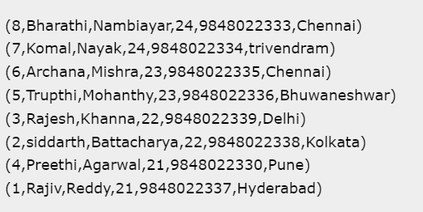
The ORDER BY operator is used to display the contents of a relation in a sorted order
based on one or more fields.
Syntax
grunt> Relation_name2 = ORDER Relatin_name1 BY (ASC|DESC);
Output
grunt> order_by_data = ORDER student_details BY age DESC;

Slide 43
The LIMIT operator is used to get a limited number of tuples from a relation.
Syntax
grunt> Result = LIMIT Relation_name required number of tuples;
Example:
grunt> limit_data = LIMIT student_details 4;

Slide 44
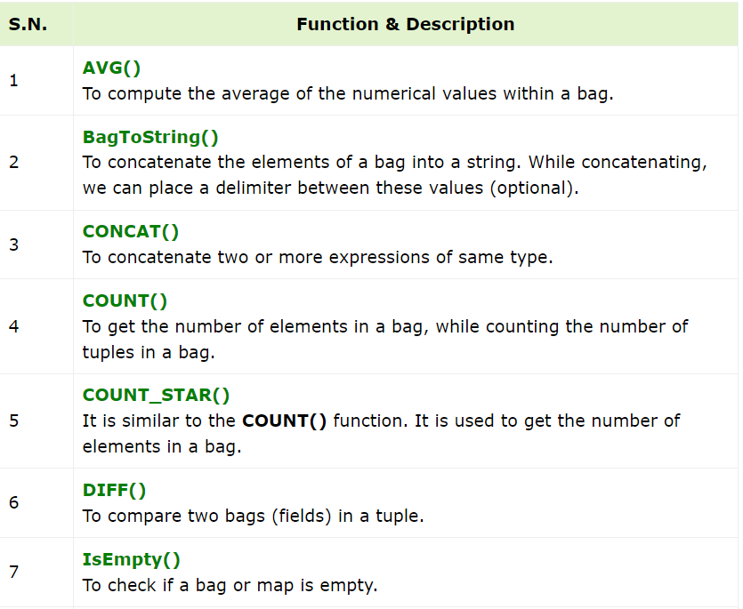
Apache Pig - Eval Functions
Apache Pig provides various built-in functions namely eval, load, store, math, string, bag and tuple functions.

Slide 45
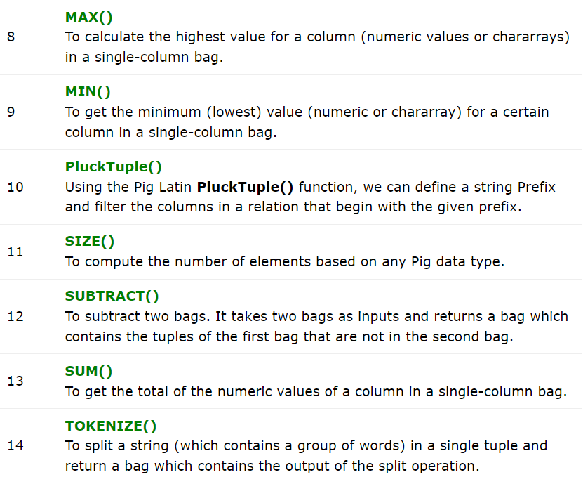
Apache Pig - Eval Functions

Slide 46
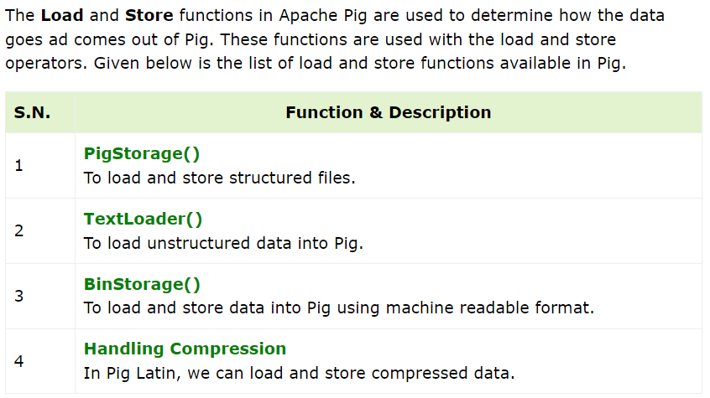
Apache Pig - Load & Store Functions

Slide 47
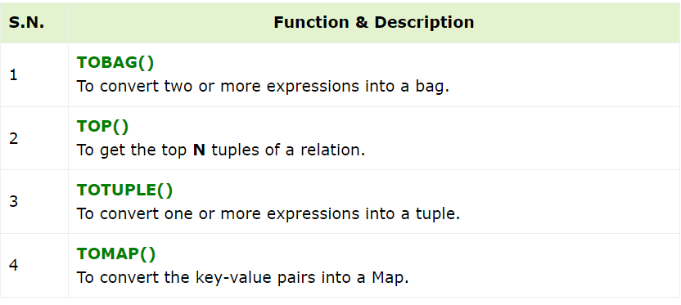
Apache Pig - Bag & Tuple Functions

Slide 48
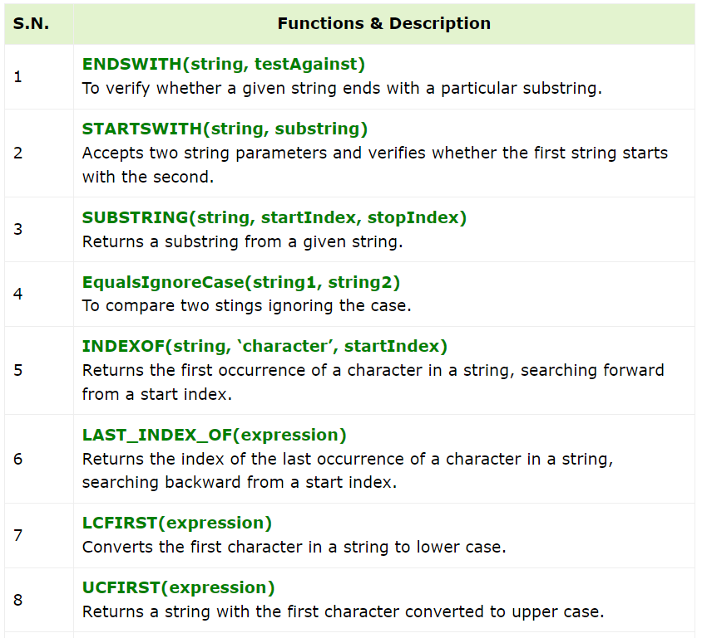
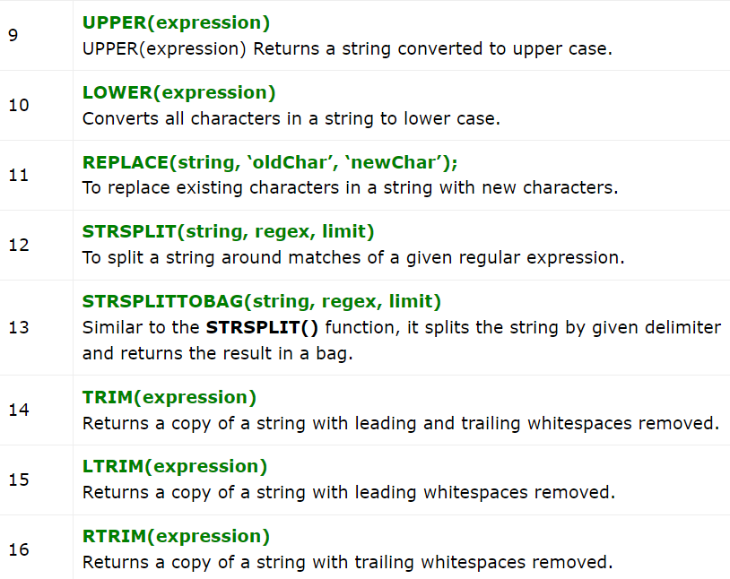
Apache Pig - String Functions

Slide 49
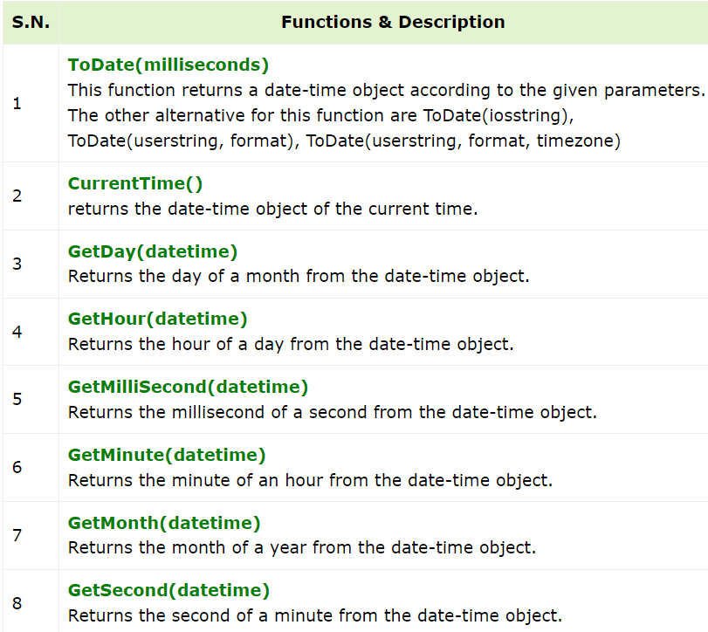
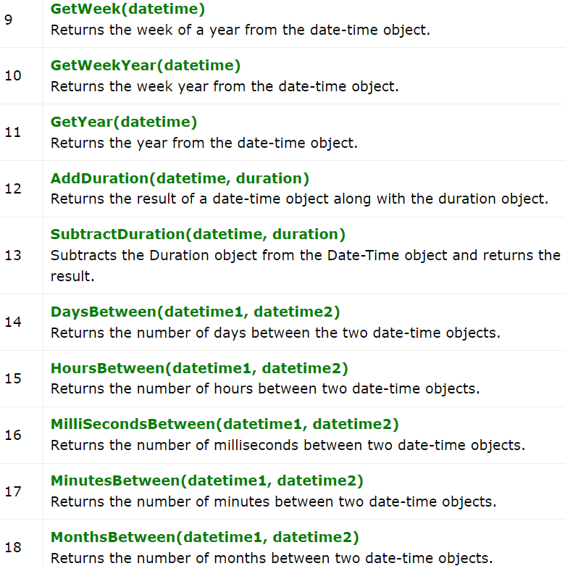
Apache Pig - Date-time Functions

Slide 50
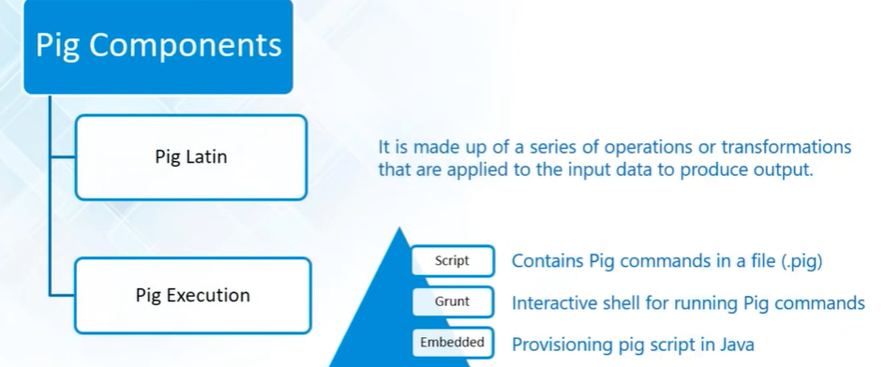
Apache Pig - Components
Various ways to execute Pig Scripts
Embedded : Execute over pigserver.
Pig Latin : Very simple data flow language given by Apache Pig .
Write , transformation and analysis can be performed over input data set

Slide 51
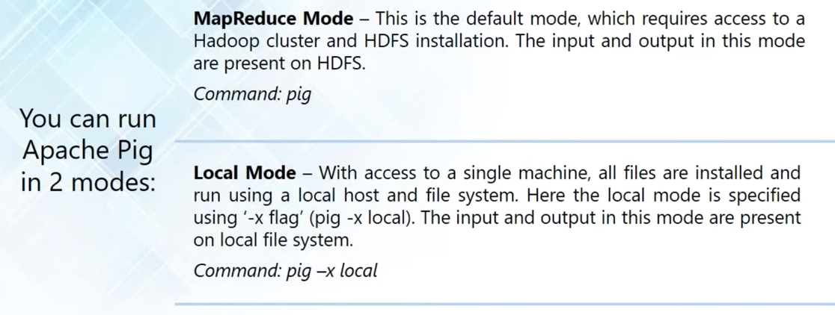
Pig – Execution Modes

Slide 52
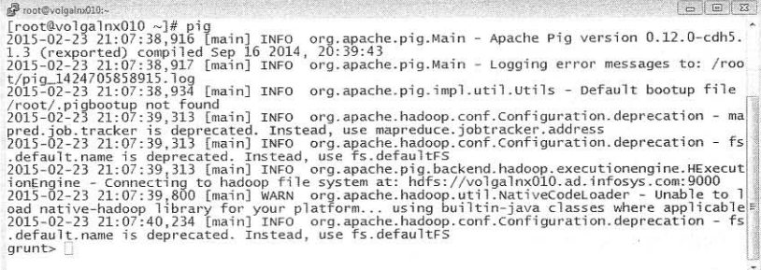
Running PIG
Interactive mode: Run pig in interactive mode by invoking grunt shell.
2. Batch mode: Create pig script to run in batch mode. Write pig latin statements in a file and save it with .pig extension

Slide 53
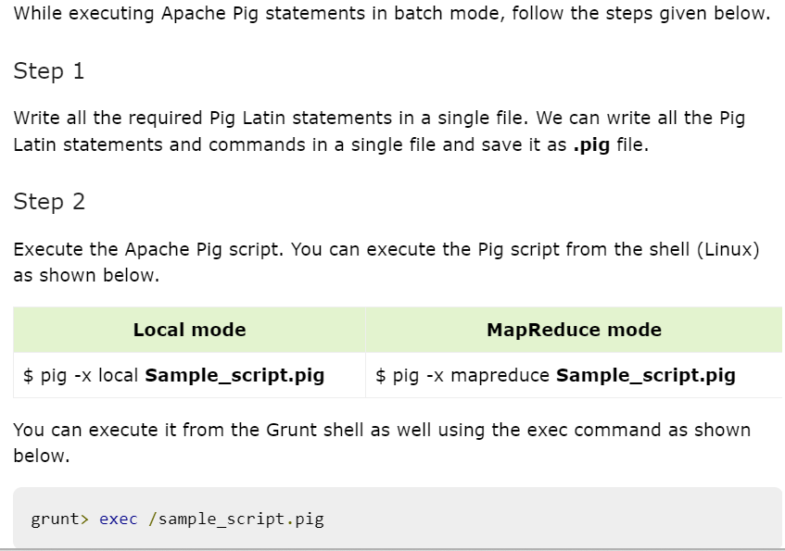
Executing Pig Script in Batch mode

Slide 54
Executing a Pig Script from HDFS
We can also execute a Pig script that resides in the HDFS.
Suppose there is a Pig script with the name Sample_script.pig in the HDFS directory named /pig_data/. We can execute it as shown below.
$ pig -x mapreduce hdfs://localhost:9000/pig_data/Sample_script.pig

Slide 55
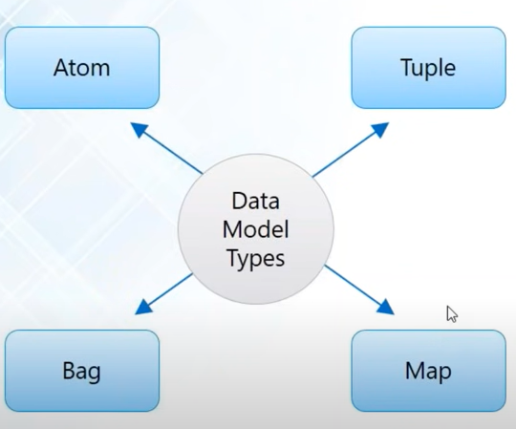
Data Model : Pig

Slide 56
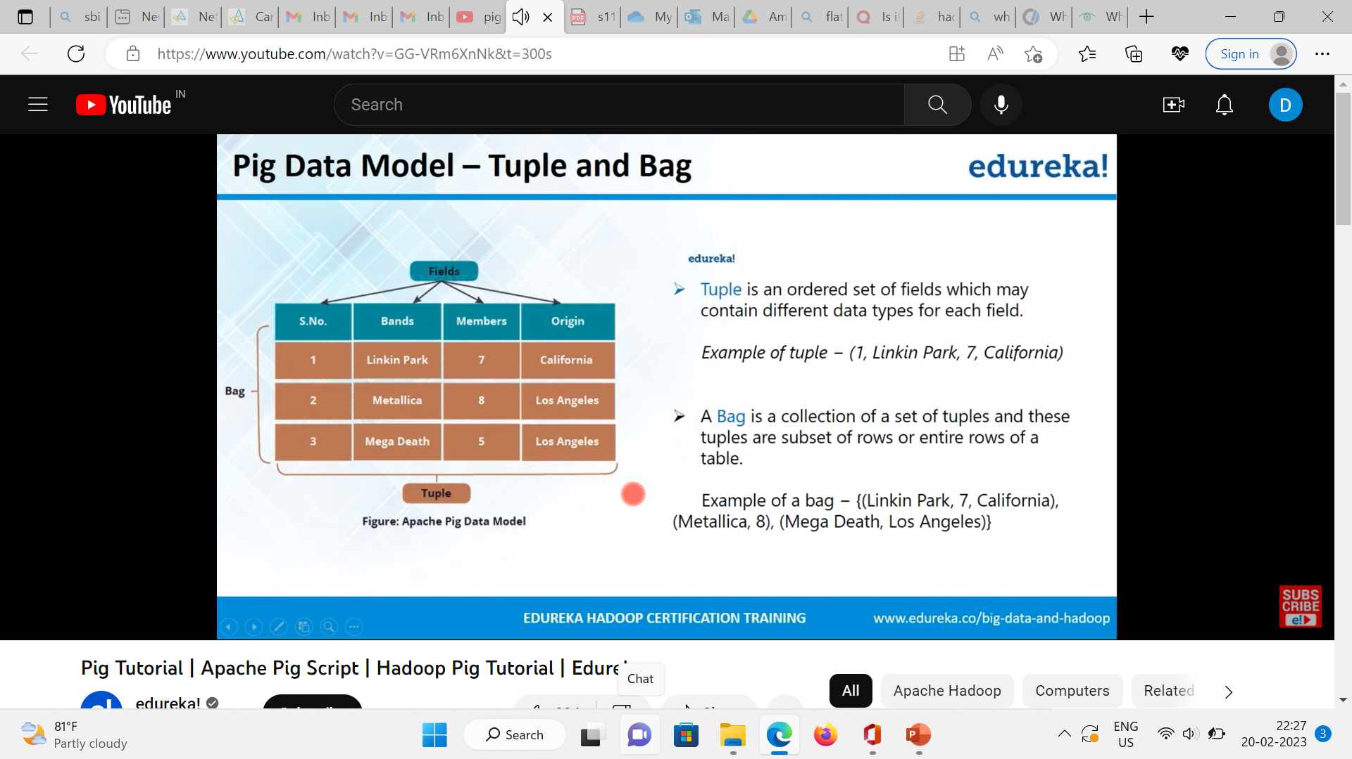
Pig Data Model: Bag & Tuple

Slide 57
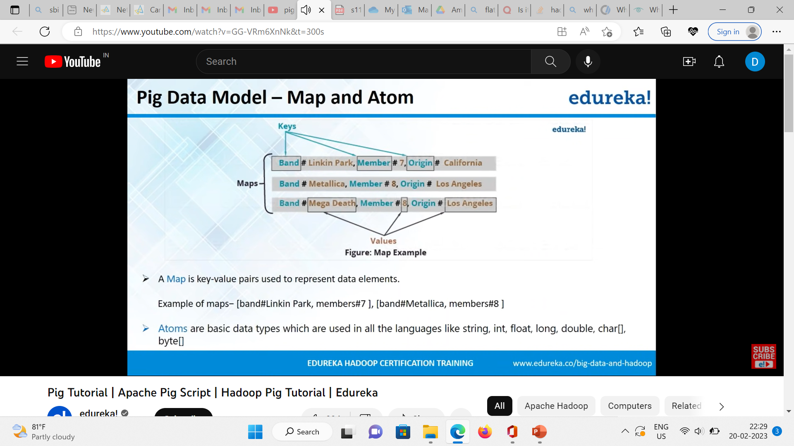
Pig Data Model: Map & Atom

Slide 58
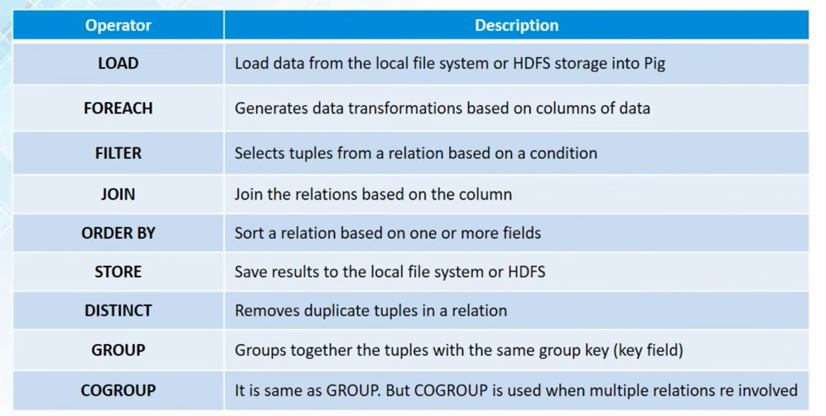
Pig: Operators

Slide 59
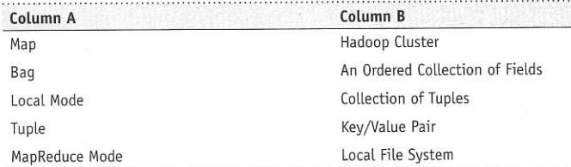
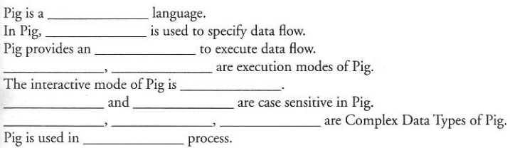
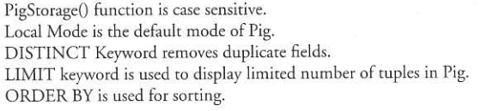
Can you Match ??????????
Fill in??????
scripting
Pig latin
Pig engine
local
mapreduce
grunt
relation
path
Bag, tuple, map
ETL
True / False ???????????

Slide 60
Piggy Bank
Apache Pig provides extensive support for User Defined Functions (UDF’s).
The UDF support is provided in six programming languages, namely, Java, Jython, Python, JavaScript, Ruby and Groovy.
For writing UDF’s, complete support is provided in Java and limited support is provided in all the remaining languages.
Since Apache Pig has been written in Java, the UDF’s written using Java language work efficiently compared to other languages.
In Apache Pig, we also have a Java repository for UDF’s named Piggybank.
User can use piggy bank functions in pig latin script and
can share their functions in piggy bank

Slide 61
PIG EXECUTION : Load and Store data locally and on Hadoop
Step1: Create input.txt file
Step2: Transfer to HDFS
hdfs dfs put /home/hdoop/input.txt bda1/
Step3: Create Pigscript file
sudo gedit pigscript.pig
OR
vi pigscript.pig
Code to be typed in pigscript.pig
record = load '/bda1/input.txt/’;
store record into '/bda1/out’;
Step4: Run pigscript in mapreduce mode
pig -x mapreduce pigscript.pig
Step5: Check the status of execution
Output: Found 2 items
-rw-r--r-- 2 hdoop supergroup 0 2024-01-12 15:05 /bda1/out/_SUCCESS
-rw-r--r-- 2 hdoop supergroup 112 2024-01-12 15:05 /bda1/out/part-m-00000
Step 6: View the output file
hdfs dfs -cat /bda1/out/part-m-00000

Slide 62
WORD COUNT PROGRAM
Step1: Create a text file and add some contents to text file
Step 2: Open .pig file and edit the following script into that
--LOAD THE DATA
records = LOAD '/pig1/input.txt';
-- SPLIT EACH LINE OF TEXT AND ELIMINATE NESTING
terms = FOREACH records GENERATE FLATTEN(TOKENIZE((chararray) $0)) AS word;
--GROUP SIMILAR TERMS
grouped_terms = GROUP terms BY word;
--COUNT THE NUMBER OF TUPLES IN EACH GROUP
word_counts = FOREACH grouped_terms GENERATE COUNT(terms), group;
--STORE THE RESULT
STORE word_counts INTO '/pig1/output';

Slide 63
Step 3: pig (type this at commond prompt )
Step4: grunt>pig wordcount.pig
Step 5: grunt>run wordcount.pig
Step 6: grunt> pwd
Step7: grunt> cd /pig1/output
Step8: grunt> ls
Output:
hdfs://192.168.159.101:9000/pig1/output/_SUCCESS<r 2> 0
hdfs://192.168.159.101:9000/pig1/output/part-r-00000<r 2> 127
Step9: grunt> cat part-r-00000
Output:
2 i
2 am
1 hi
2 in
1 are
2 how
1 too
2 you
1 Data
2 good
1 hope
1 you.
1 Btech
1 about
1 doing
1 manipal
1 science.
1 studying

Slide 64


Slide 65


